Slide 1


NINJA POSTAL CORPORATION

Slide 2


Team Members
Aagam Shah (8935540)
Gurjeet Kaur (8942986)
Ramya Kanapuram (8836752)
Anjali Priyanka Guntupalli (8954881)
Eshwitha Dunna (8914435)

Slide 3
Introduction
Ninja Postal Corporation specializes in deliveries from Asia to North America.
This design is to maintain secure and scalable network infrastructure for Tokyo, Toronto and Vancouver headquarters.

Slide 4
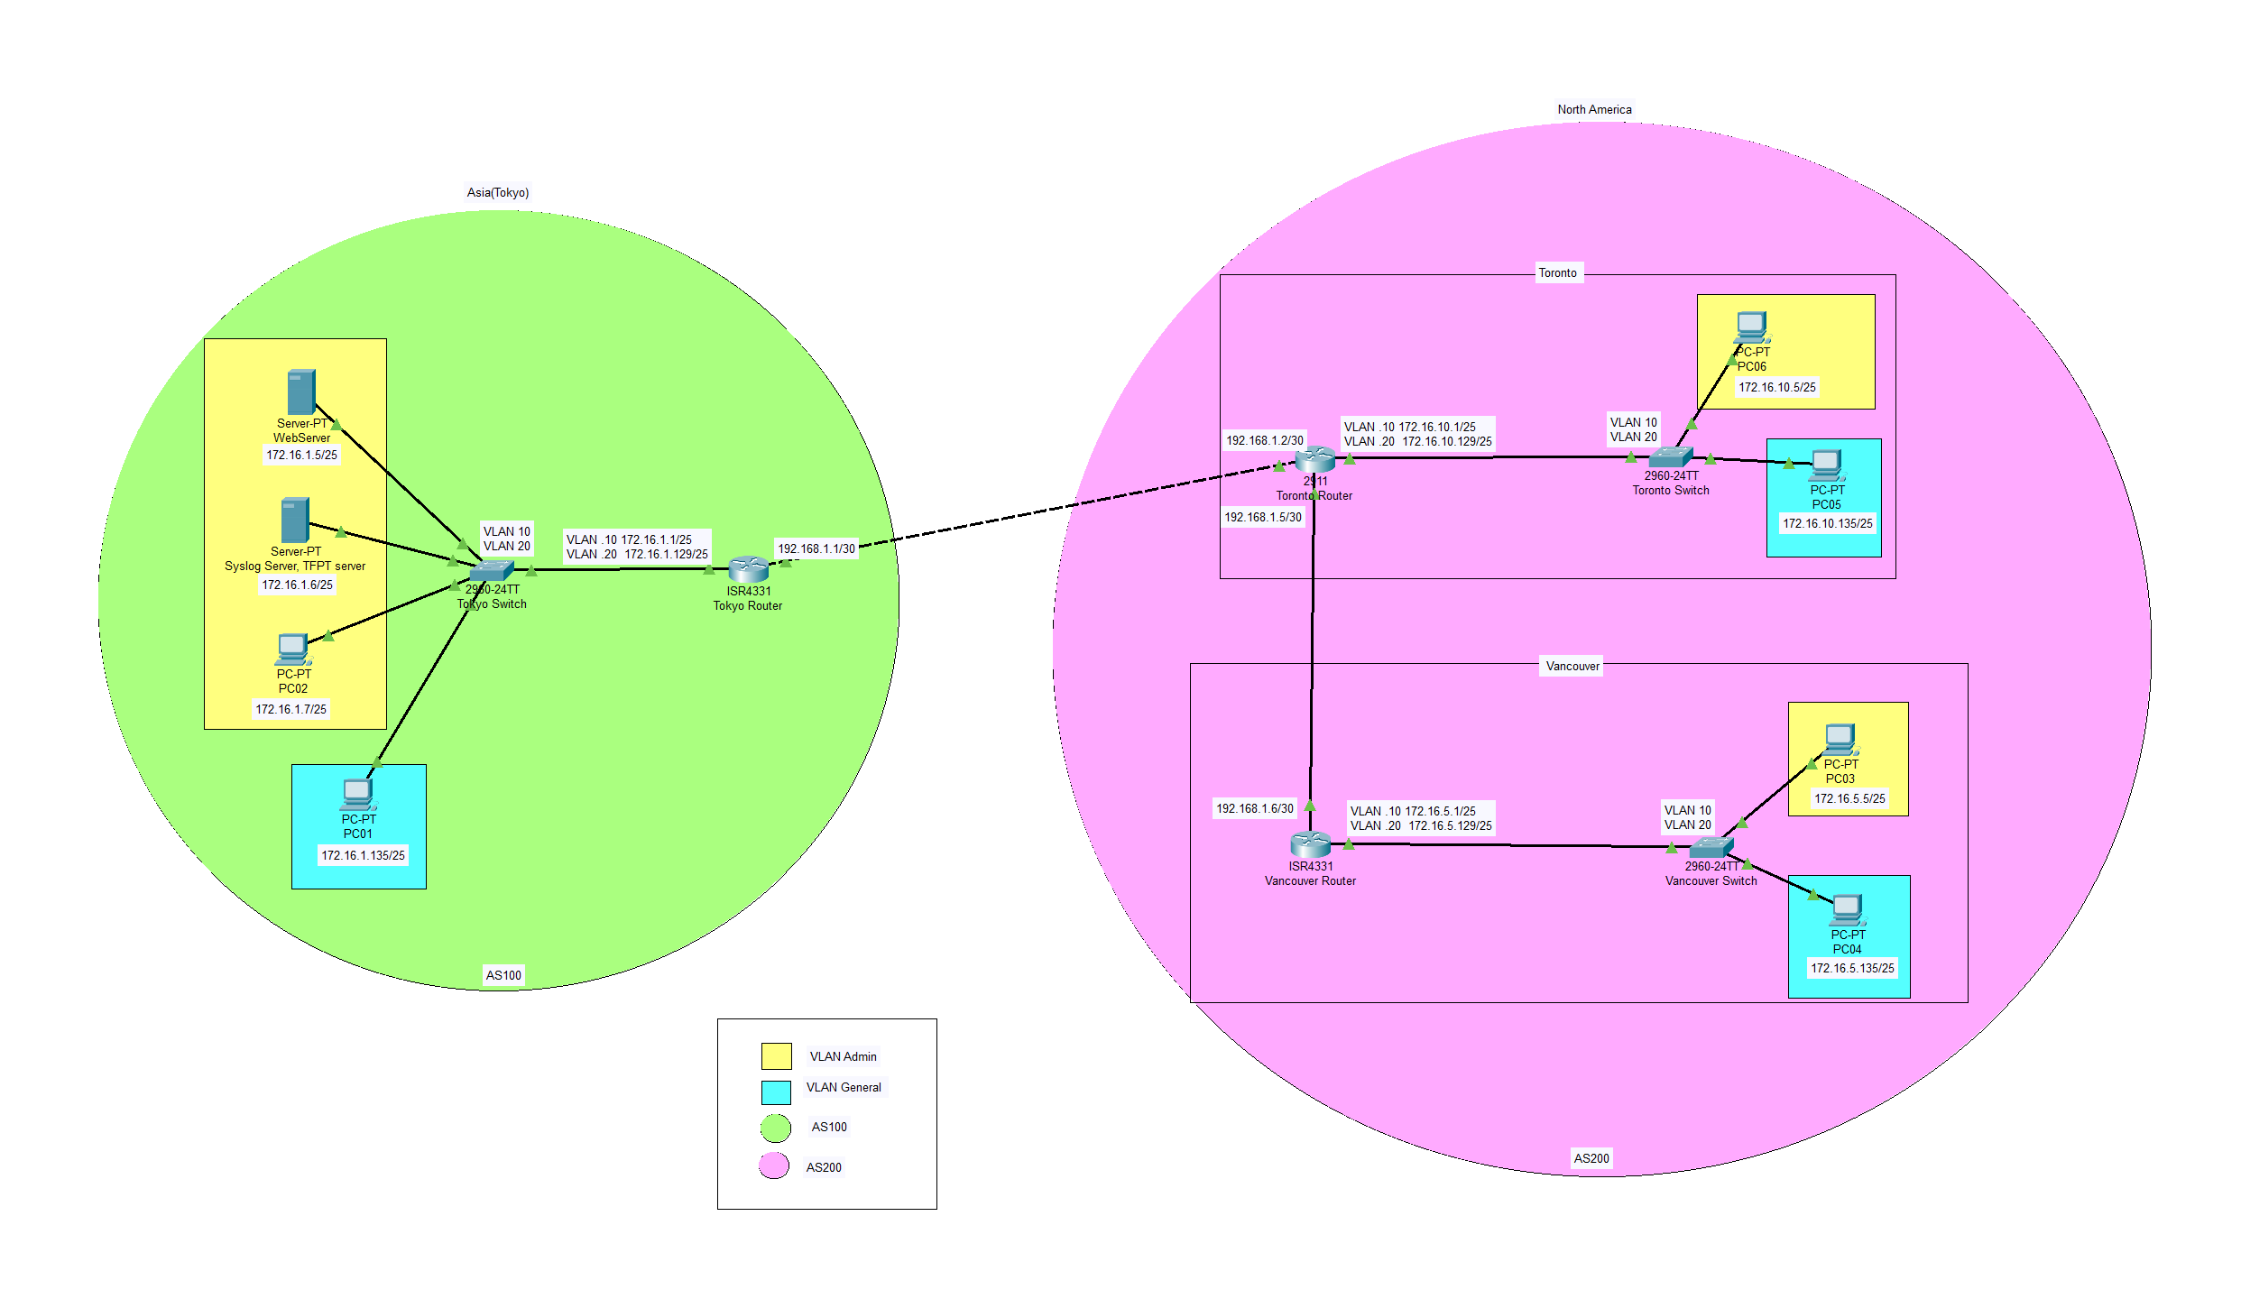
Network Topology

Slide 5
Design Justification & Overview
Autonomous Systems (AS): Two separate AS’s, one for Japan and another for Canada. It ensures secure communication within each region.
Access Control: ACL: It restricts unauthorized access to sensitive data. RBAC: It enhances security by defining roles and permissions.
Webserver in Tokyo: Vancouver has full access from Tokyo whereas Toronto is limited to ping requests.

Slide 6
Design Justification & Overview (Cont.)
Routing Protocol: EIGRP is used for rapid intra-office communication and BGP for precise inter-office routing. It provides Fast Convergence, Optimal Routing and Redundancy.
VLAN Implementation: VLANs enhance performance, Security and Isolation, Bandwidth Efficiency and Simplified Management.
Additional Security Measures: Syslog Event Violation Mode monitors suspicious events. TFTP Servers in Tokyo provide secure file transfer capabilities.

Slide 7
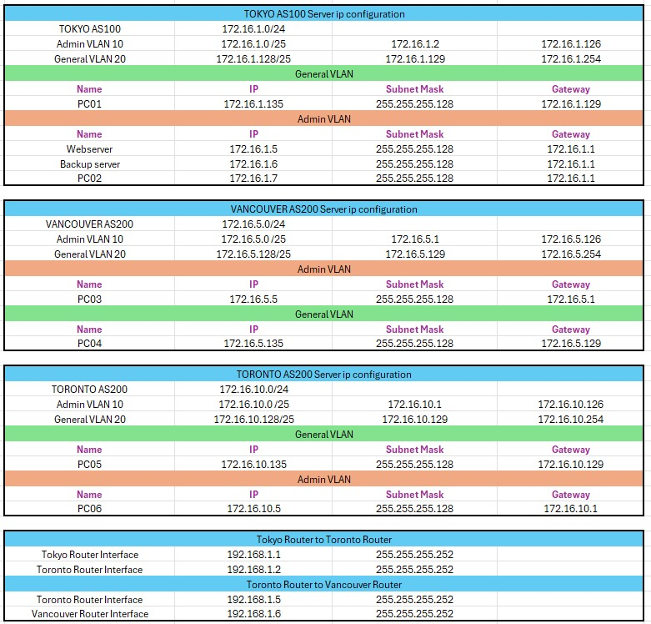
IP Configuration Matrix

Slide 8
Security & Compliance Overview
ACL: It controls traffic flow and restricts access to network resources. Implementation: It permits traffic from Admin VLAN in Vancouver to Tokyo web server. Denies traffic from General VLANs to Admin VLANs. Restricts access to management interfaces based on RBAC roles.
RBAC: It controls user access to critical network devices. Limits access based on user roles within the organization. Implementation: It defines three user roles: Admin, Network Operator, Helpdesk. Access permissions can be granted or denied based on ACLs.

Slide 9
Security & Compliance Overview (Cont.)
Port-Security: It prevents unauthorized device connections. Centralizes logging for monitoring and troubleshooting. Implementation: Port-Security limits each port to one connected device.
Syslog: Syslog events are sent to centralized server in Tokyo for auditing.
TFTP Server: It centralizes location for device configuration backups and updates. Security Measures: Access restricted based on RBAC roles. Regularly updated passwords and secure file transfer protocols implemented. Limited access to TFTP server from specific management VLANs. Regular monitoring and auditing of TFTP server activity logs.

Slide 10
Futureproofing & Scalability
Scalability: New VLANs can be added to accommodate organizational growth and expansion into new locations.
Redundancy: Redundant hardware components are implemented to reduce the impact of hardware failures, ensuring continuous network availability. Automatic failover to secondary connections is made in case of primary connection failure.

Slide 11
Futureproofing & Scalability (Contd.)
Dynamic Routing Protocol: EIGRP and BGP provide flexibility and easy integration of new technologies into the network topology.
Security Measures: RBAC and ACL implementations are designed to enhance security. Adjustments to security measures can be made as the organization grows and evolves.

Slide 12
Conclusion
Our proposed network design for Ninja Postal Corporation ensures secure and scalable communication between its offices, meeting current and future requirements.
The implementation of VLANs, dynamic routing protocols, ACLs, RBAC, and centralized services guarantees security, performance, and ease of management.

Slide 13
Thank You!

